Slide 1


Expense Tracker

Slide 2


Submitted By:
NAKIB AL AL HASAN SABBIR
ID: 221-15-4760
Section : 61_C2
Fall 2024
Department Of Computer Science & Engineering
Submitted To :
Mr. Deawan Rakin Ahamed Remal
Lecturer
Department Of Computer Science & Engineering

Slide 3


Objective
Enable secure user registration and login to manage financial data.
Provide an intuitive interface for tracking income, expenses, and remaining balance.
Allow users to add, update, and delete transaction records easily.
Categorize transactions as income or expenses for better organization.
Display a detailed transaction summary with type, date, name, and amount.
Warn users when expenses exceed their income to promote financial control.
Support multiple users without data conflicts using local storage.
Ensure accessibility by deploying the application on a web-based platform.

Slide 4


Simplifies personal financial management with an intuitive interface.
Supports secure multi-user functionality with separate data handling.
Provides real-time tracking of income, expenses, and balances.
Offers features to add, edit, and delete financial transactions.
Alerts users when expenses exceed income for better financial control.
Generates a detailed transaction summary for analysis.
Web-based deployment ensures easy accessibility across devices.
Project
Scope

Slide 5
Features
User Registration and Login
Transaction Management
Real-Time Balance Tracking
Expense Alerts
Detailed Summary
Multi-User Support
Local Storage
Web-Based Deployment

Slide 6
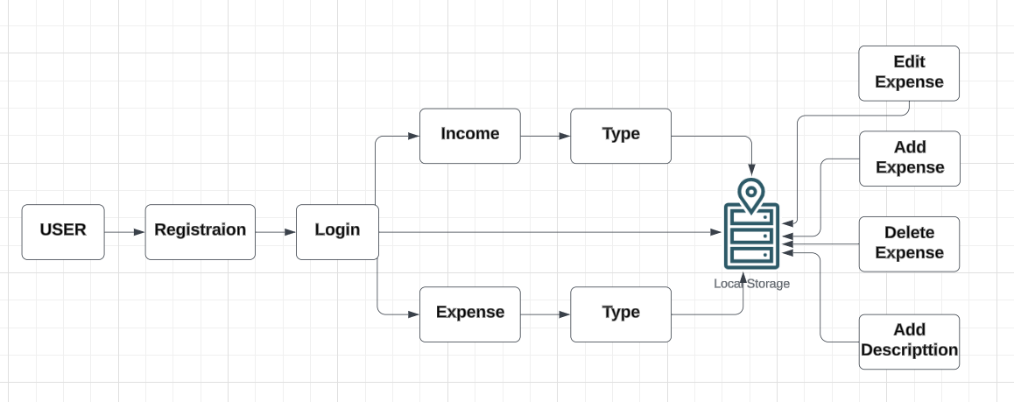


System
Design

Slide 7



Technology
Stack
Frontend: HTML, CSS, JavaScript
Data Storage: Local Storage (Browser-Based)
Deployment: Netlify

Slide 8


Development
Phases
Requirement Analysis: Defined project needs and goals.
Design: Developed the UI and planned the system architecture.
Implementation: Built features using HTML, CSS, JavaScript, and integrated local storage.
Testing: Ensured functionality and fixed issues.
Deployment: Deployed the project on Netlify.
Feedback and Optimization: Gathered feedback and refined the project.

Slide 9


Challenges and Solutions
User Security:
Solution: Implemented password hashing and encryption.
2. Data Management:
Solution: Used unique identifiers for user data.
3. UI Complexity:
Solution: Simplified the user interface design.
4. Validation:
Solution: Added client-side validations and error handling.
5. Scalability:
Solution: Built a scalable architecture.

Slide 10

Conclusion
The Expense Tracker project successfully manages personal finances with an accessible, secure, and user-friendly platform. It simplifies income and expense tracking, supports multi-user access, and ensures data security through local storage and encryption. The scalable architecture allows efficient handling of increasing user demands and data. While there are some limitations, such as reliance on local storage and lack of server-side processing, these are mitigated by its intuitive design and robust client-side validations. Future enhancements could include cloud storage integration and mobile app compatibility.

Slide 11
Thank you!

